Slide 1
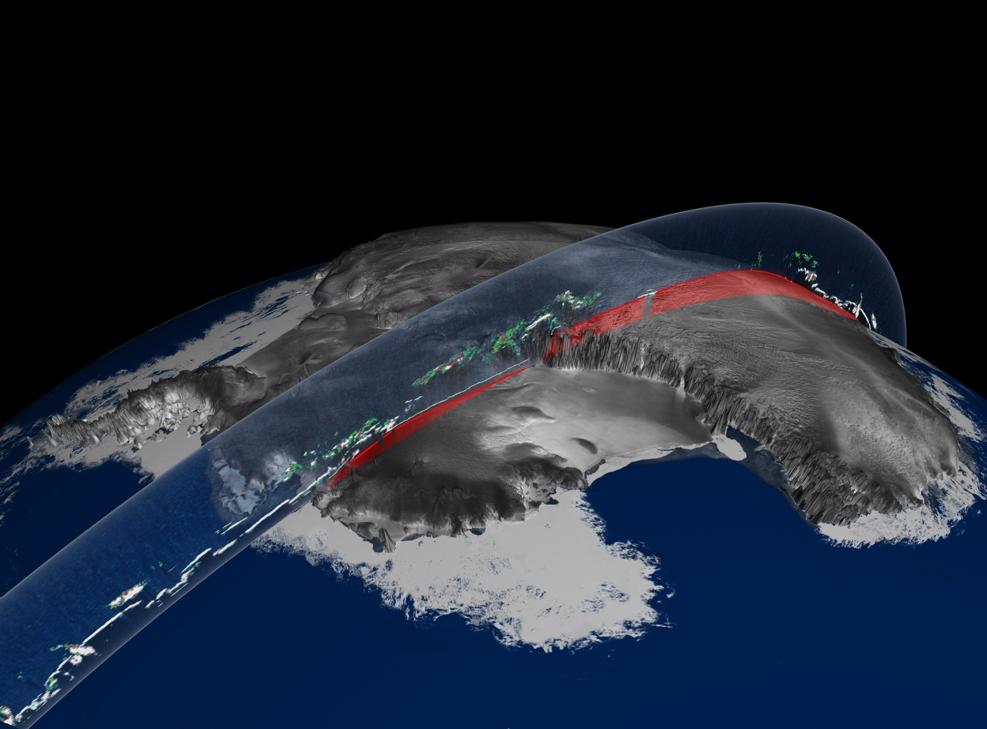


Observing Pole to Pole – A virtual observing system
Global Inter-agency IPY Polar Snapshot Year (GIIPSY)
WMO Space Task Group
NASA ICEsat
Participating International Agencies: ASI, CSA, CMA, CNES, DLR, ESA, EUMETSAT, INPE, JAXA, NASA, NOAA, ROSHYDROMET, WMO, WCRP-CLiC

Slide 2
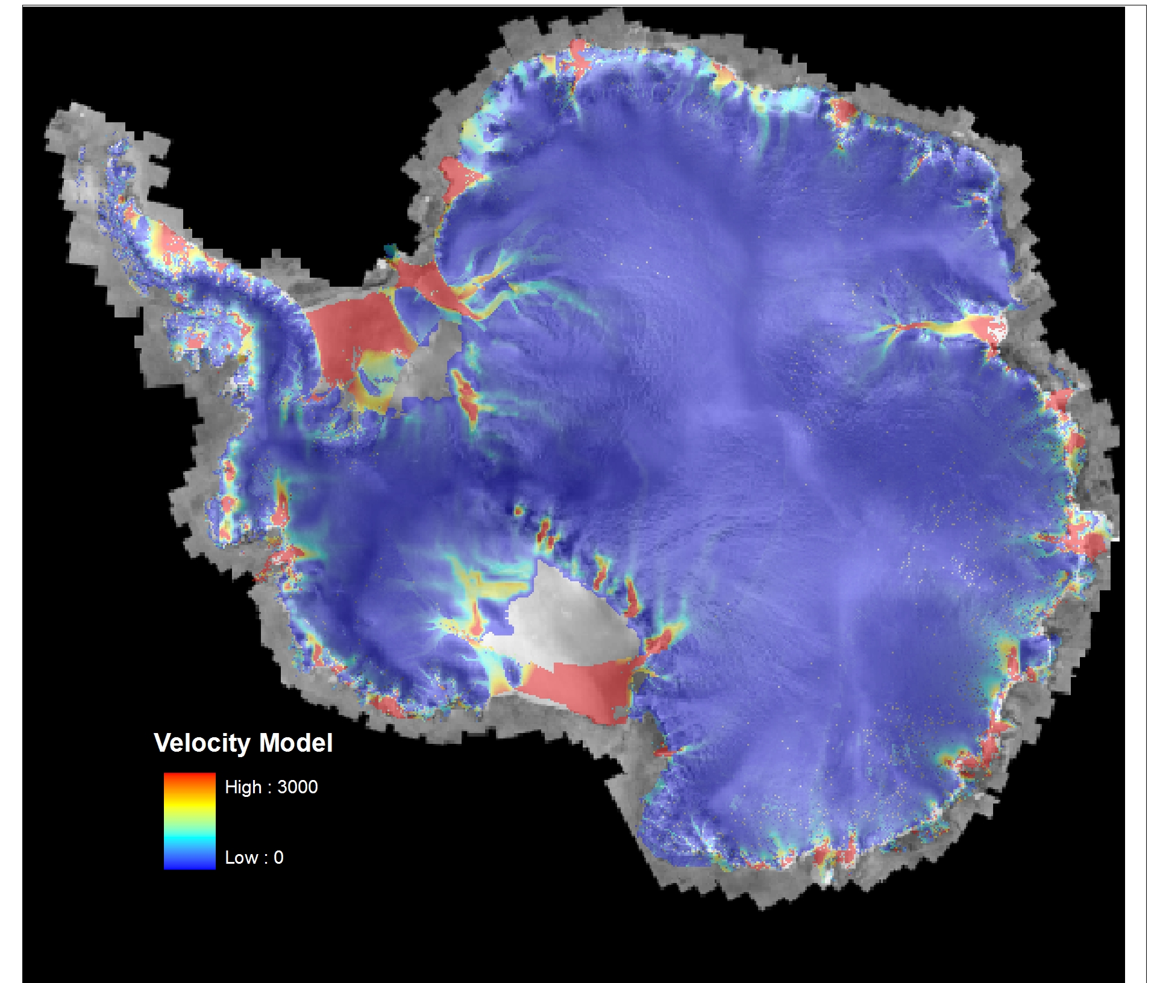


Climate Change and the IPY 2007-2008
The IPY provided an international framework for understanding polar processes and high-latitude climate.
Spaceborne technology offered unique capabilities for obtaining essential data for predictive models.
IPY era spaceborne instrumentation represented a technological leap beyond the capabilities of the IGY
2000 Modified Antarctic Mapping Mission ice velocity model. A precursor activity to GIIPSY and the STG (K. Jezek)

Slide 3
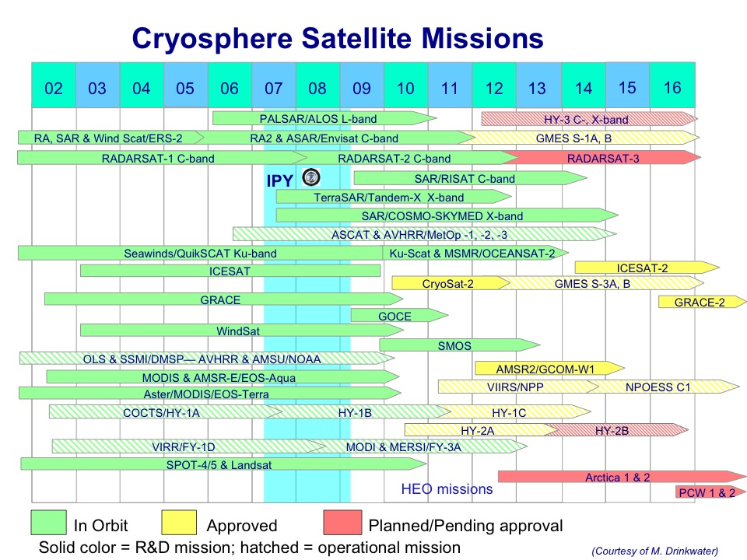
Notes:
Note gaps between IceSAT and IceSAT-2; GRACE and GRACE-2

Slide 4
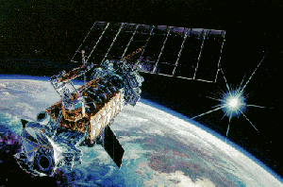
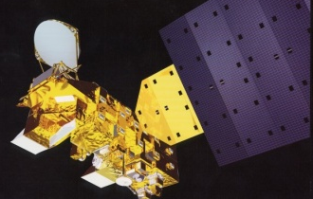
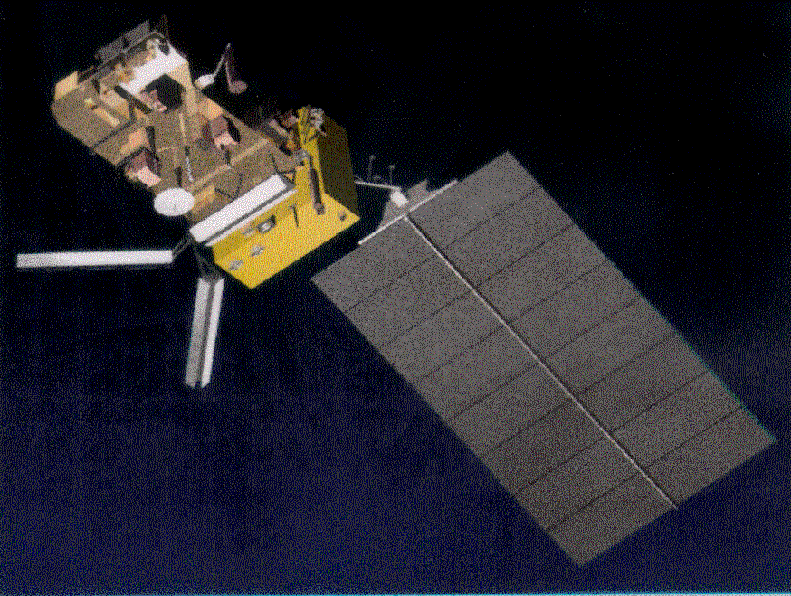
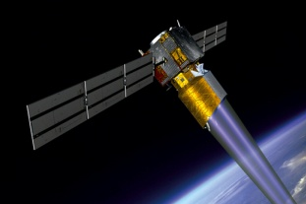

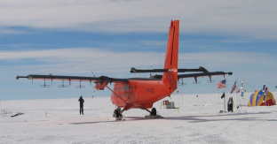
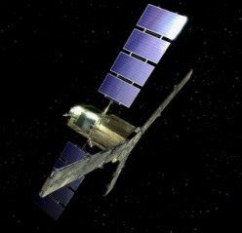
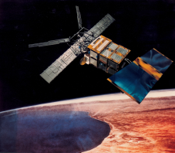
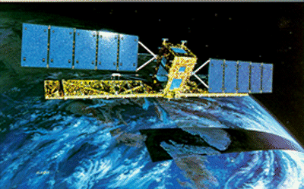
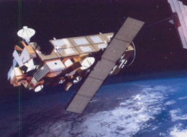
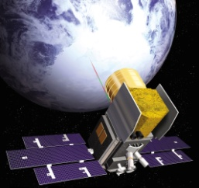
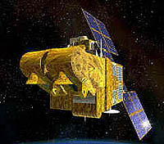

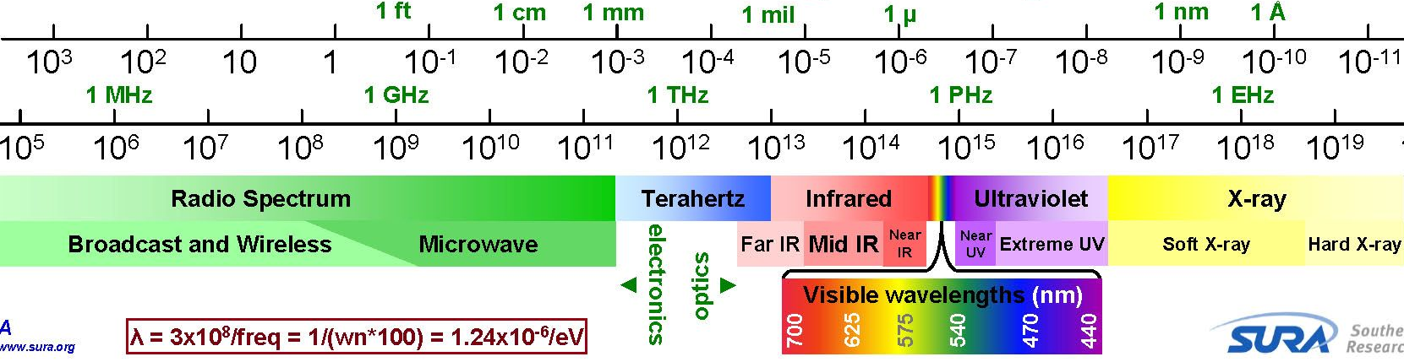
Collecting satellite polar snapshots
Aqua &
Terra
METOP
DMSP
GRACE
Aircraft and in-situ
Sounders and GPR
Systems
SSMI
AMSR-E
MODIS / ASTER
ASCAT
AVHRR
ADM-Aeolus
SMOS
Envisat
IceSat
ERS-2
RADARSAT
ASAR MERIS / A-ATSR
SPOT-4
GOCE
ALOS
PALSAR
PRISM / AVNIR-2
HRVIR / VGT
wavelength (m)
Frequency (Hz)
Gravity

Slide 5
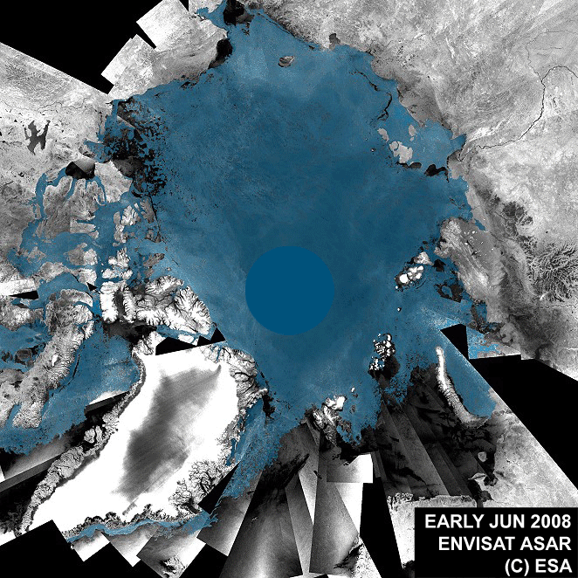
GIIPSY
The 1957 IGY began the rigorous scientific investigation of the Polar Regions.
The 2007-08 IPY goes beyond the IGY through the numbers and capabilities of earth observing satellites. These systems can routinely observe the poles and cast polar processes within the context of the global environment.
In November 2005, the Global Interagency Polar Snapshot Year (GIIPSY) project was established to develop consensus requirements on polar science objectives that could best and perhaps only be met with Earth observing satellites

Slide 6
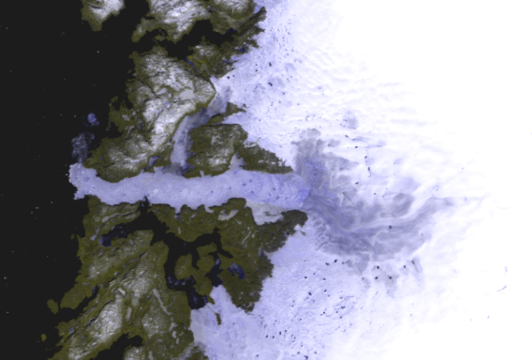
GIIPSY Strategy
Work with the science community to compile IPY science data requirements
Identify those requirements which will be satisfied through routine operations (eg MODIS, MERIS)
For routine observations, work with flight agencies to assure that data are available/archived in some standardized fashion
Identify those requirements that can only be satisfied by non-routine tasking, processing and distribution. Work with the flight agencies to acquire these data in a fashion that distributes the operational load.
Following selection of projects through the national A.O.’s, identify whether any legacy data sets are absent from the acquisition plans. Make necessary requests.
GIIPSY science requirements and related documentation are posted at www.bprc.osu.edu/rsl/GIIPSY

Slide 7

WMO IPY Space Task Group (STG)
The STG is the body convened by the WMO tasked with addressing how to meet the IPY space observation requirements developed by GIIPSY.
The STG was established to coordinate agency planning, processing and archiving of IPY Earth observation legacy data sets.
It is comprised of nominated representatives from Brazil, Canada, China, France, Germany, Italy, Japan, Russian Federation, United Kingdom , United States, and both the European Space Agency and The European Organization for the Exploitation of Meteorological Satellites, the later two of which alone represent 26 nations.
STG coordinates across CEOS and CGMS Agencies.
Notes:
The main work concentrated on achieving the observational requirements as defined through
Pre-IPY Town Hall meetings at AGU
Space Agency IPY Announcements of Opportunities,
IGOS-P Cryosphere Theme
WCRP CliC
SCOBS IPY survey of institutional observation requirements
5 STG meetings + 3 SAR Coordination meetings + 4 telecons

Slide 8
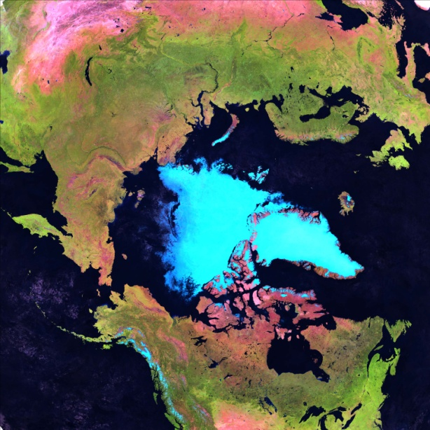
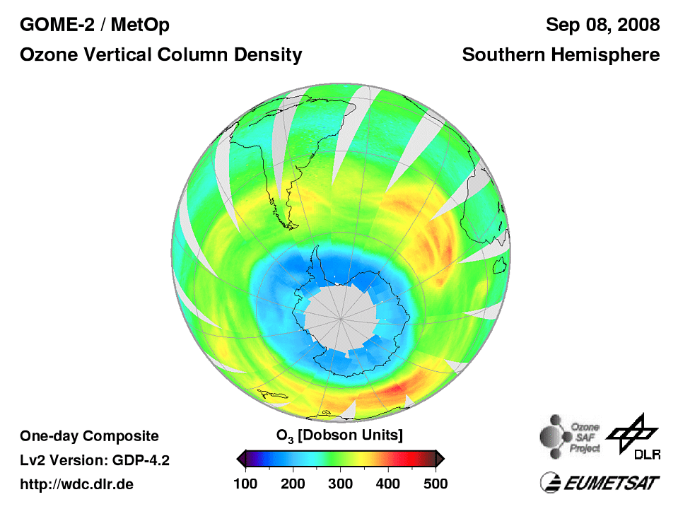
STG Strategy
Satisfy GIIPSY science requirements in a fashion that distributes the acquisition and processing loads across agencies
Select projects that are compatible with the operational mandates of individual agencies and commercial partners
Encourage participation of other nations as additional polar observation capabilities are developed
Identify a limited number of the most important scientific objectives achievable within the STG framework and within the IPY time period.
Participating International Space Agencies: ASI, CSA, CMA, CNES, DLR, ESA, EUMETSAT, INPE, JAXA, NASA, NOAA, ROSHYDROMET, WMO, WCRP-CLiC

Slide 9
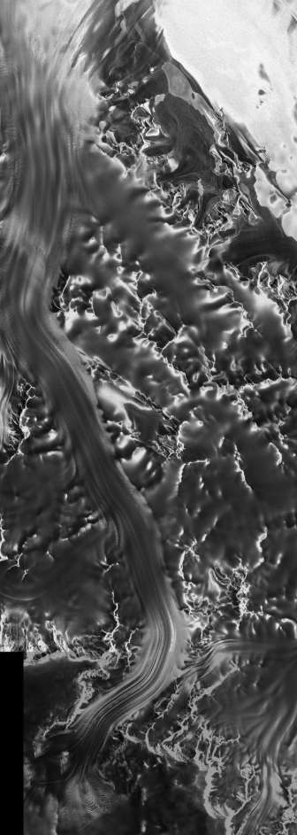
STG Goals
The STG initially accepted 4, primary objectives based on the GIIPSY requirements. Polar meteorology and atmospheric chemistry goals were later added.
Pole to coast multi-frequency InSAR measurements of ice-sheet surface velocity.
Repeat fine-resolution SAR mapping of the entire Southern Ocean sea ice cover for sea ice motion.
One complete high resolution visible and thermal IR (Vis/IR) snapshot of circumpolar permafrost.
Pan-Arctic high and moderate resolution Vis/IR snapshots of freshwater (lake and river) freeze-up and break-up.
TerraSAR-X image of Leverett Glacier and the South Pole Traverse Route

Slide 10
Ice Sheets

Slide 11
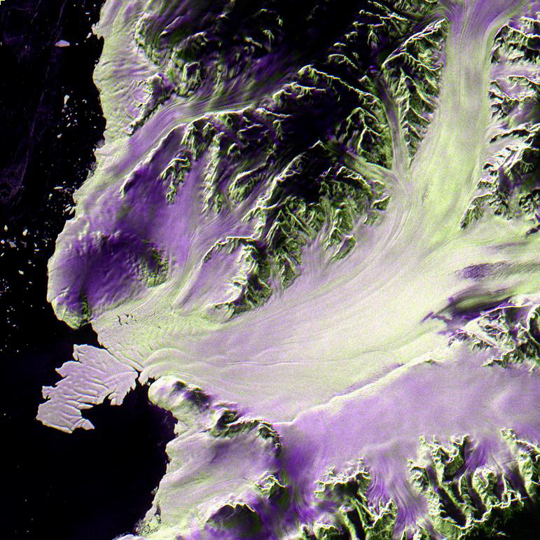
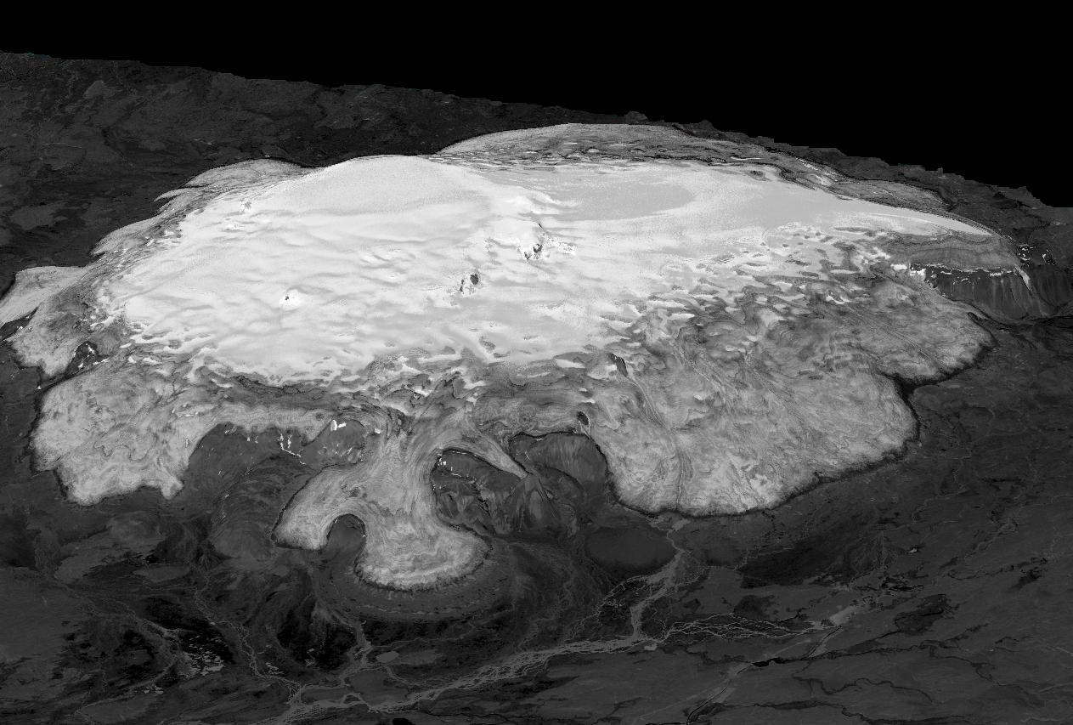

Multisensor data provide new views of the polar ice sheets
RADARSAT 2 Multi-pol color composite of Antarctic outlet glaciers
HH, HV, HH-HV
SPOT stereo digital elevation model from CNES SPIRIT project. Hoffsjökull Ice Cap, Iceland

Slide 12
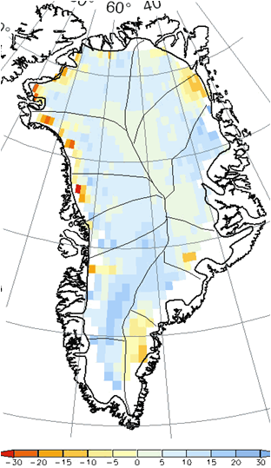
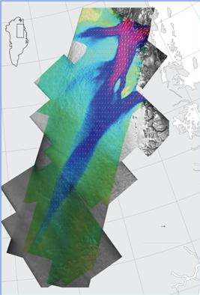
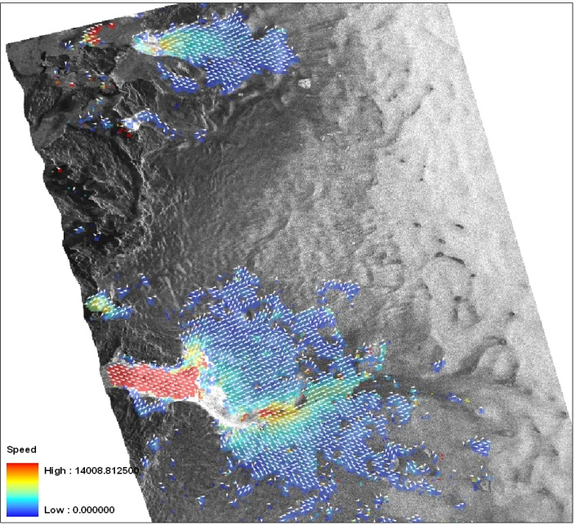
Greenland ice-sheet dynamics & change
Courtesy Joughin et al
Altimeter Topographic Change (cm)
Courtesy Jezek et al
Courtesy Johannessen et al

Slide 13

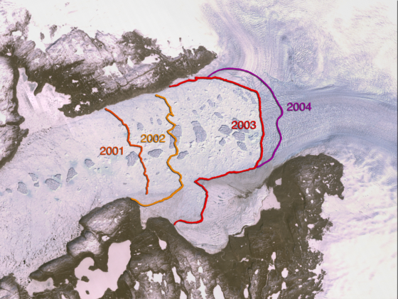
Greenland ice-streams
JAXA
JakobshavnIsbrae
JAXA
DLR
-X
ESA

Slide 14

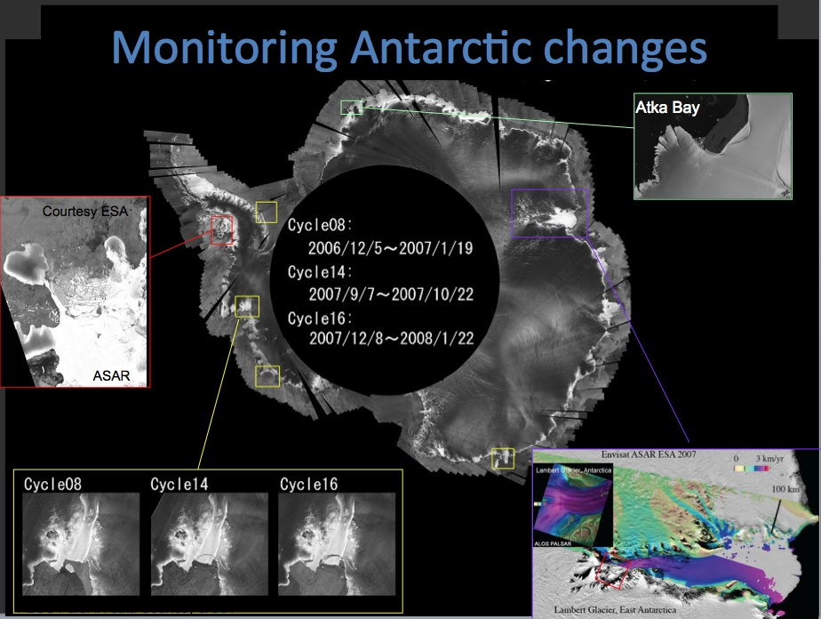
Notes:
Advanced Synthetic Aperture Radar (ASAR) on Envisat

Slide 15
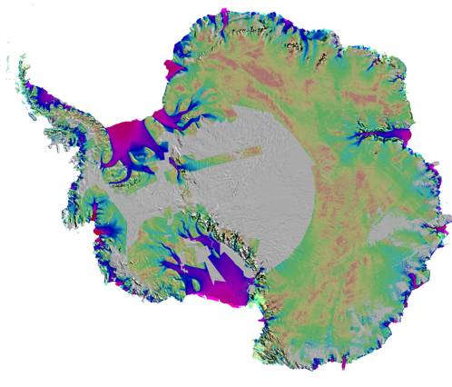
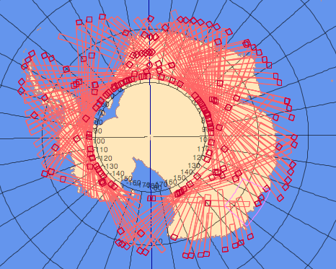
Ice-sheet change in Antarctica
Altimeter – Topographic Change
SAR – Ice Flow Dynamics
Courtesy Wingham et al
Courtesy Rignot et al
-150 | +150
Rate of change of elevation (mm/yr)

Slide 16
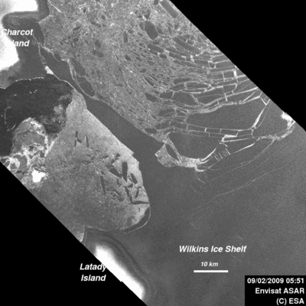
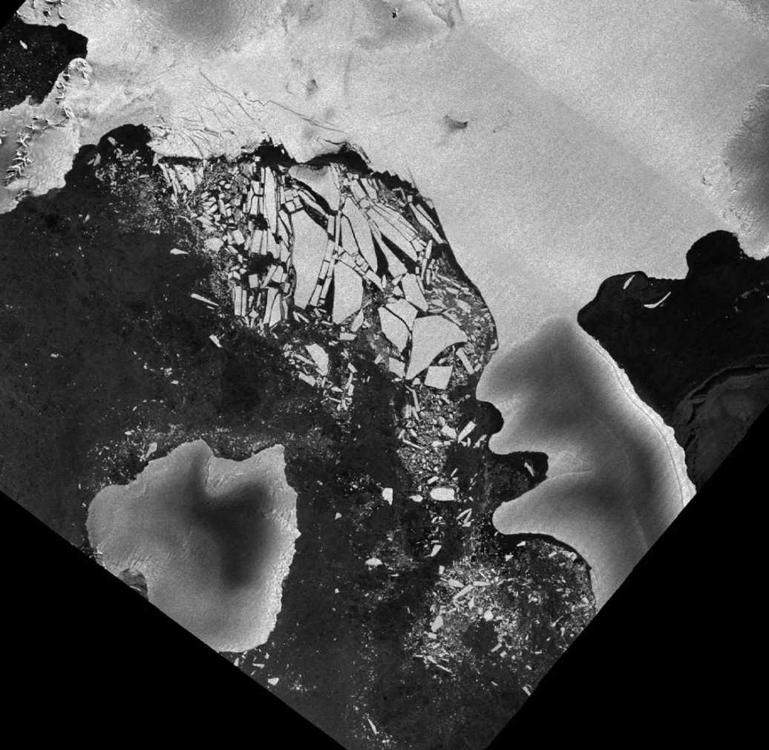

Wilkins Ice Shelf disintegration
2009-09-04 HR
ASI Cosmos Skymed
Charcot Island Antarctic
Latady Island

Slide 17
  For the first time, pole to coast multi-frequency InSAR measurements of ice-sheet surface velocity

Slide 18
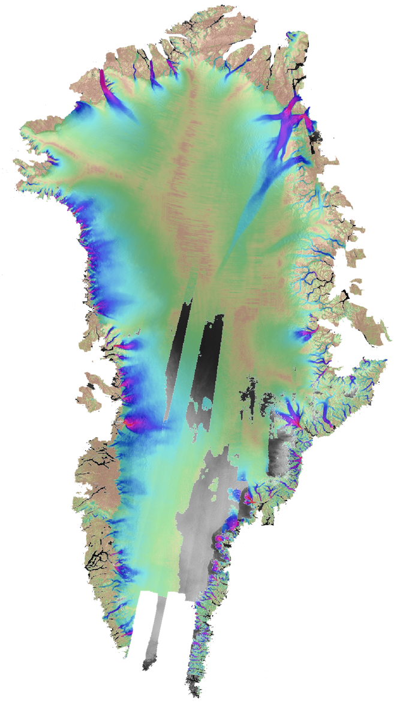
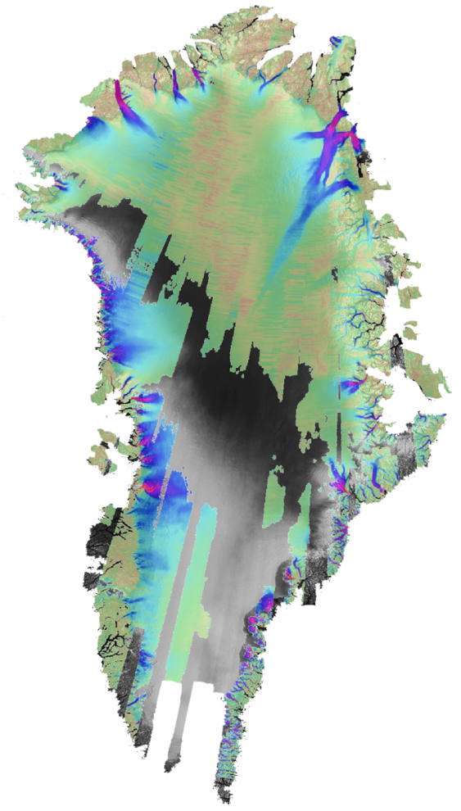
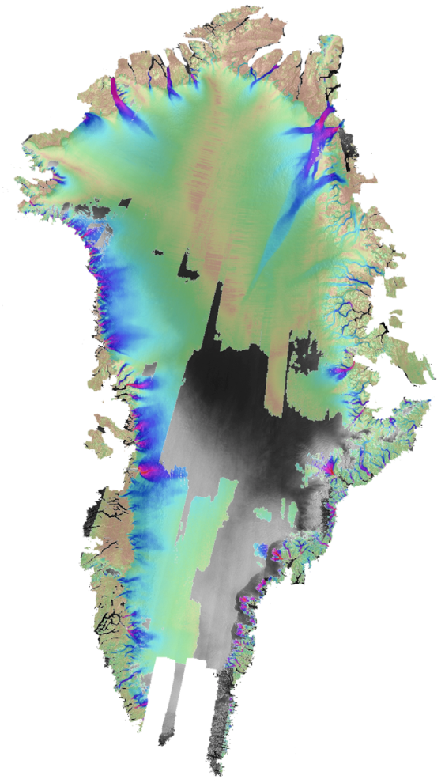
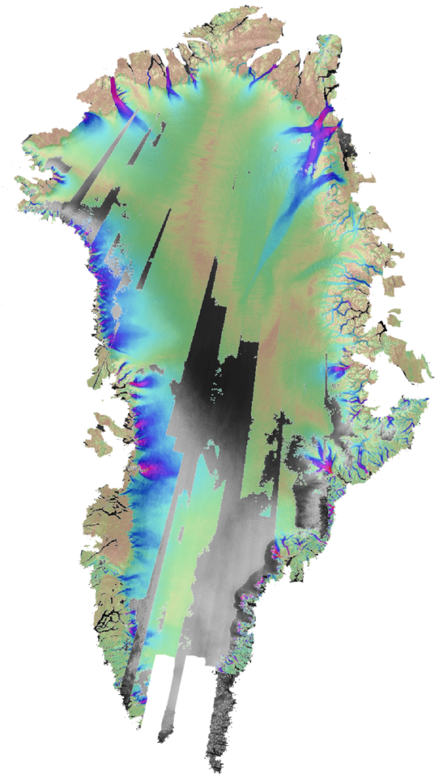
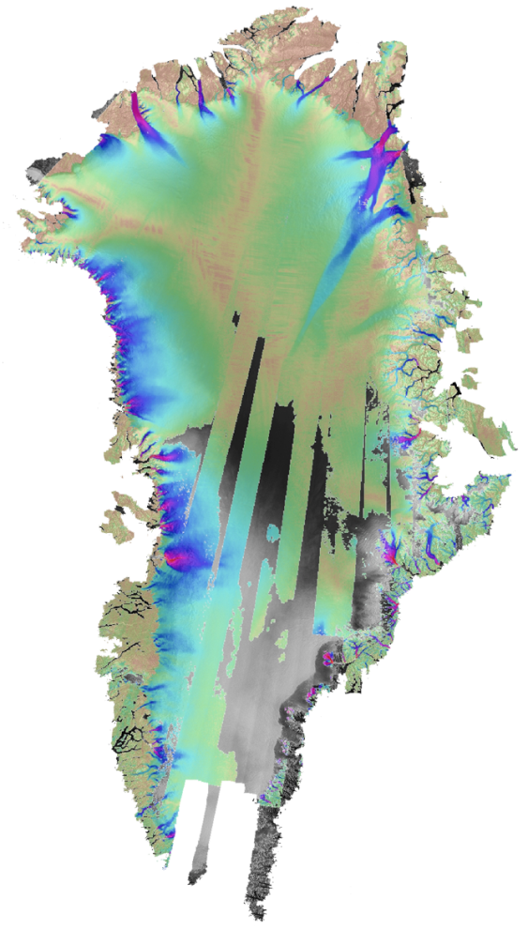

2000
Composite
2006
2007
2008
Greenland Ice Mapping Project
RADARSAT data provided by CSA,
archived and distributed through ASF, and processed by the University of Washington under contract to NASA

Slide 19
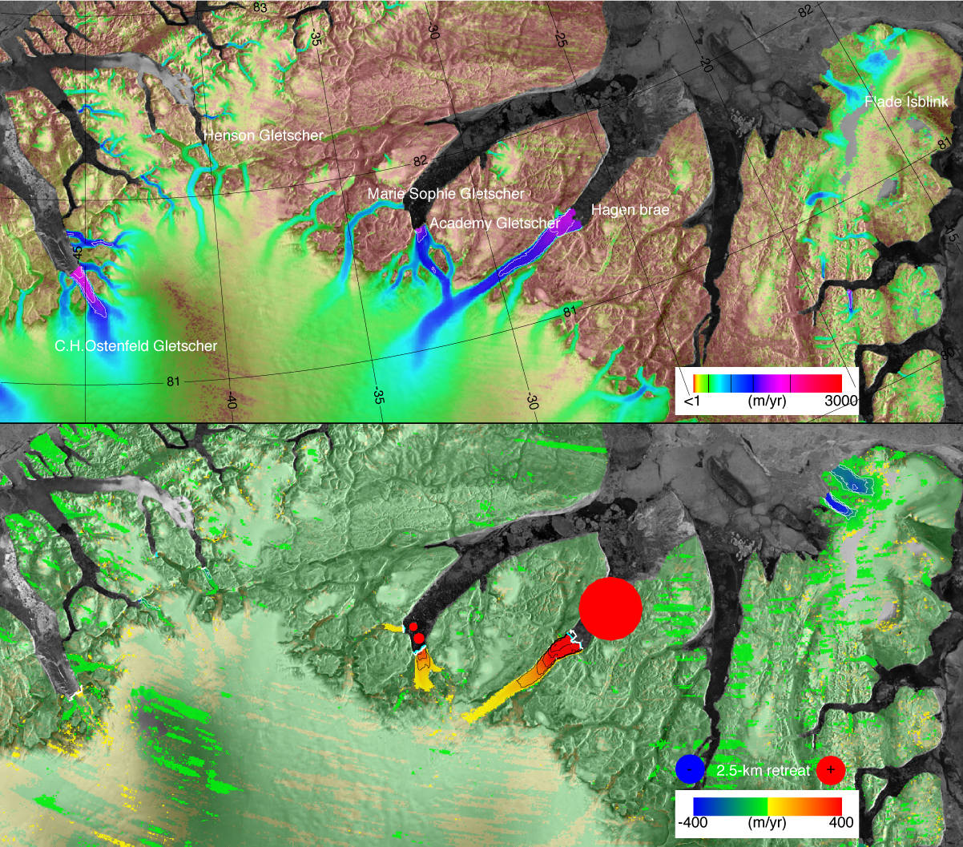
Northern Greenland Glacier Speed Change – 2000 to 2006
2006 Flow Speed
Change from 2000 to 2006
Courtesy I. Joughin

Slide 20
Recovery Glacier – T-SAR-X

Slide 21
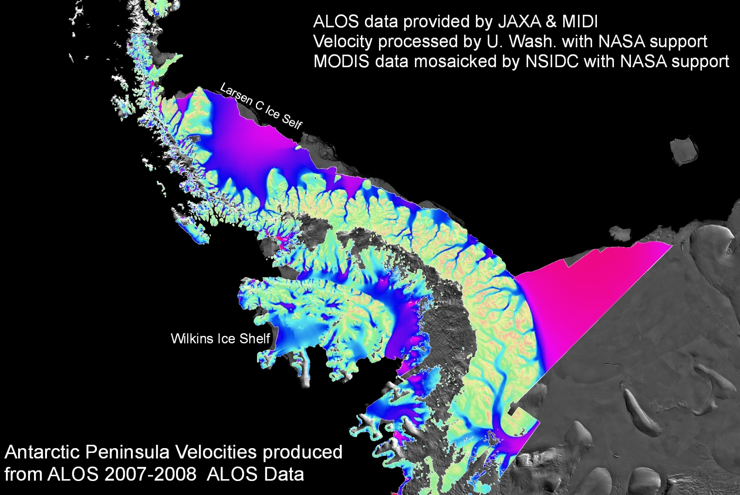

Slide 22
Sea Ice

Slide 23
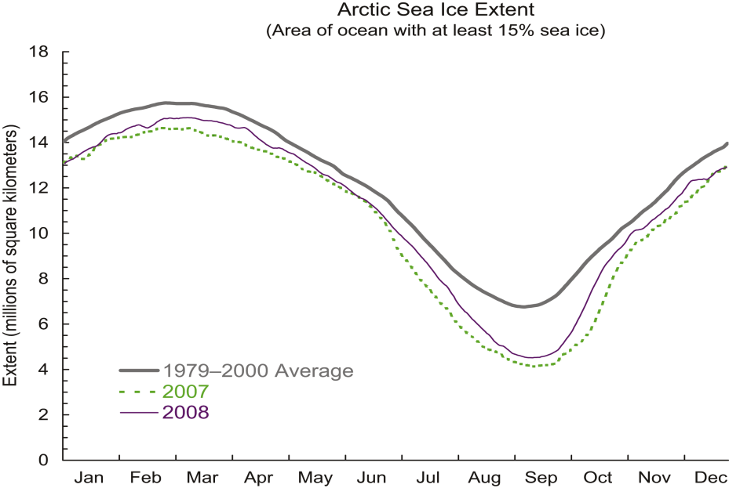
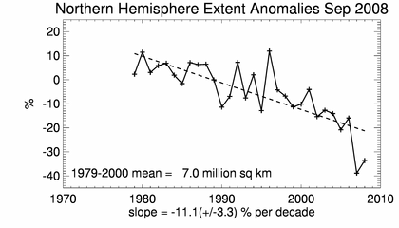
Arctic sea ice changes

Slide 24
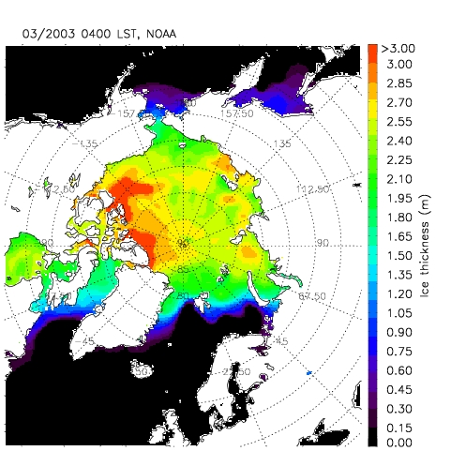
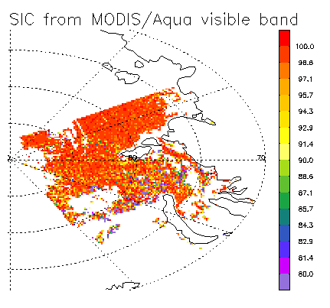
New Ice Products from AVHRR, MODIS, SEVERI
Sea Ice Concentration
Sea Ice Thickness

Slide 25
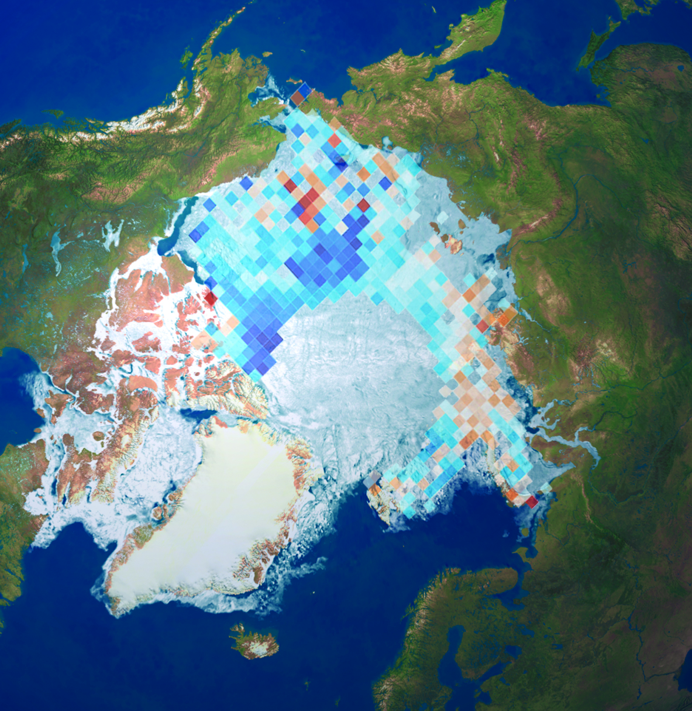
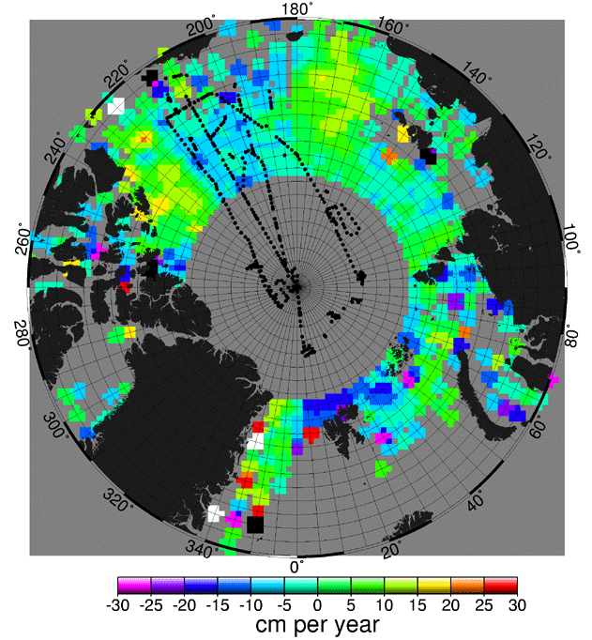


Arctic Sea-Ice Thickness Change
Envisat: 2008 ice anomaly
ERS-1/2: 1993-2002
Courtesy K. Giles et al (2008)
Courtesy S. Laxon

Slide 26
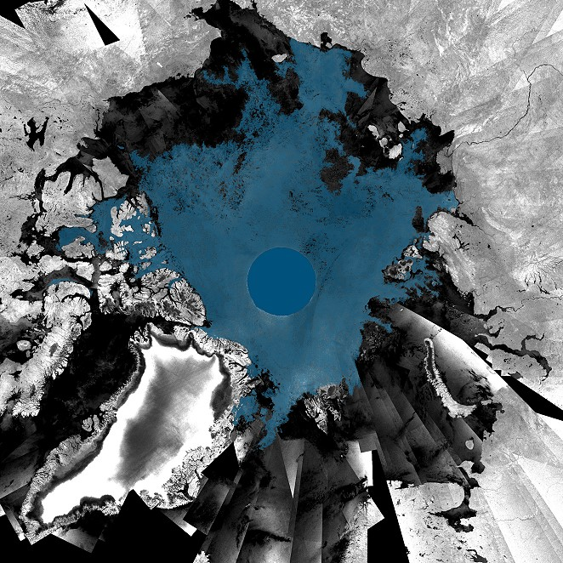
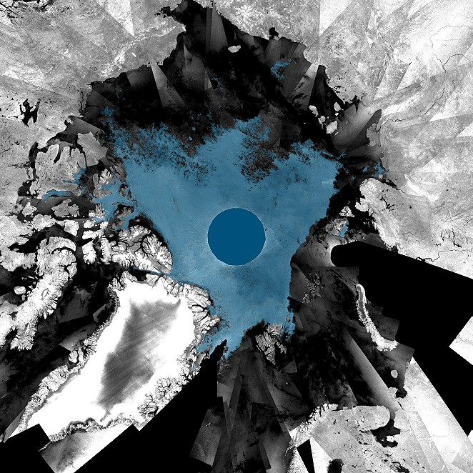
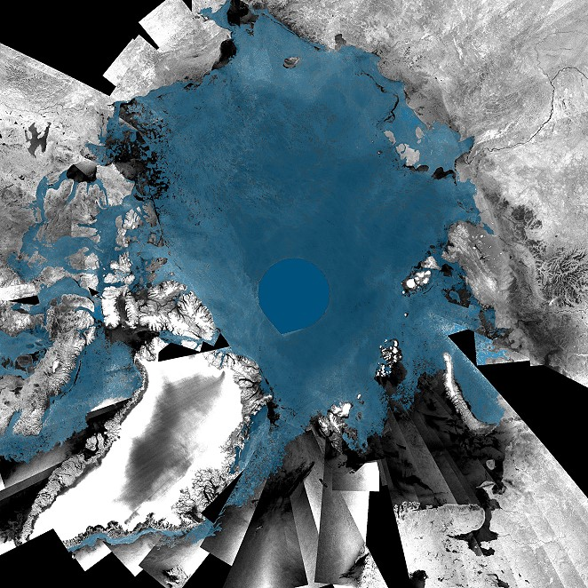
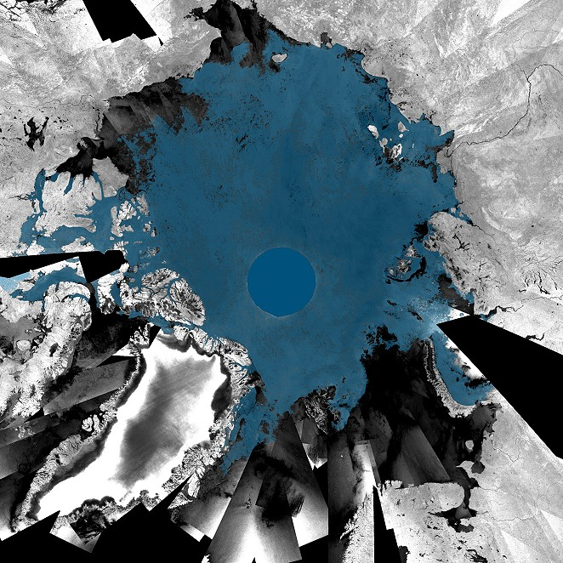
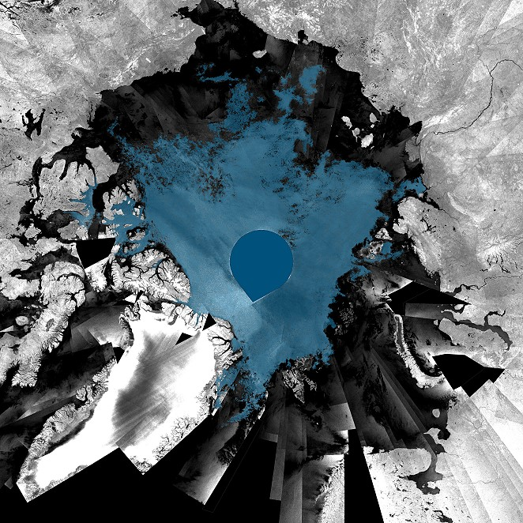

2008 Arctic sea ice extent
Early September 2008
Early August 2008
Early July 2008
End August 2008
Early June 2008
Canada
Russia
Greenland
ASAR GMM
mosaic

Slide 27
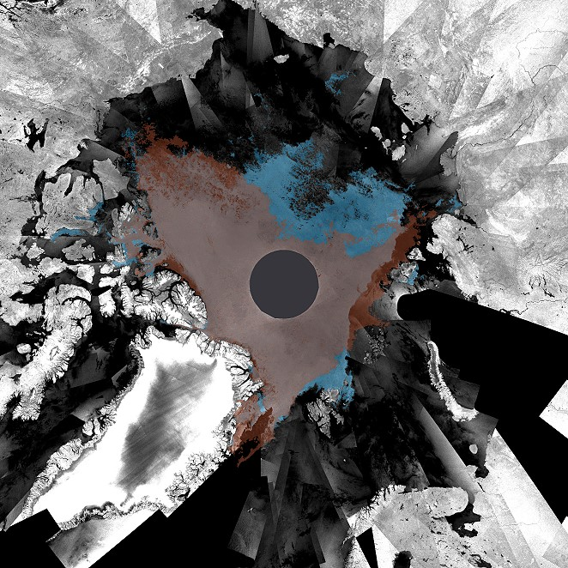

2008 Arctic sea ice extent
2007: lowest minimum
2008: second lowest minimum
Canada
Both passages open
Russia
ASAR
Global Monitoring Mode
mosaics
Greenland
Early September 2008

Slide 28

Arctic Sea-Ice Drift
AMSR-E IFREMER
2-day ice drift: April 30, 2008 → May 02, 2008
http://www.seaice.dk/test.N/

Slide 29
  For the first time, repeat fine-resolution SAR mapping of the entire Southern Ocean sea-ice cover for sea ice motion

Slide 30

ASAR
Global Monitoring Mode (GMM) – 1km resolution
Antarctica monthly
sea ice extent

Slide 31

Envisat ASAR 3-day sea ice drift
4-7 July, 2008
http://www.seaice.dk/polarview/google.s/latest.GMMdrift.kml
Notes:
Latest attempts to derive sea ice drift underway for Weddell and Ross Sea regions.

Slide 32

Routine Antarctic Sea ice Drift
Courtesy DTU – PolarView
http://www.seaice.dk/test.S/

Slide 33
  For the first time, one complete Bipolar high & moderate resolution visible and thermal IR and SAR snapshot - for ice sheet, circumpolar snowcover and permafrost applications

Slide 34



Visible/IR Image Mosaics of the Poles
SPOT VGT 1km daily mosaics (courtesy CNES)

Slide 35



Circumpolar Clear Sky Composites
USGS/Landsat
ESA/MERIS
Winter snow pack
Spring thaw – Siberian Thermokarst
MODIS Mosaic - Courtesy NRCan & NASA

Slide 36
River and Lake Ice

Slide 37
  For the first time, Pan-Arctic high resolution Vis/IR and SAR snapshots - for lake and river freeze-up and break-up and other applications

Slide 38




ALOS: AVNIR-2 (10m) & PRISM (2.5m)
Acquired
Acquired
Cloud Free
Cloud Free
Notes:
Blue AVNIR-2 Red: PRISM

Slide 39

Arctic Optical Coverage
Envisat MERIS Data Viewer
See MERAVI:
http://miravi.eo.esa.int
Pechora River, Russia
Envisat - MERIS – 300m optical image of Arctic tundra
Notes:
This Envisat image, acquired by Envisat’s Medium Resolution Imaging Spectrometer (MERIS) instrument on 10 March 2008, features the Nenets Autonomous Okrug region and an icy Pechora Sea in Arctic Northwest Russia. The Nenets Autonomous Okrug has shorelines on the Barents (blue water in upper left hand corner), White (visible on left side of image) and Kara seas (not visible). The round snow-covered depression visible in the upper left hand corner is Kolguyev Island.

Slide 40

Daily Optical (Visible/InfraRed)
SPOT VGT 1km daily mosaics (courtesy CNES)
Notes:
Low resolution optical and IR data contributed by CNES via SPOT VGT.
USGS have committed a circumpolar product from Landsat.

Slide 41

NRCan VGT mosaics
Corrected for BRDF & cloud effects (courtesy, Government of Canada, Natural Resources Canada, Earth Sciences Sector and Canadian Space Agency)
Notes:
The NRCan/ESS Program Reducing Canada's Vulnerability to Climate Change (RCVCC) supports a research activity committed to national scale medium-resolution EO data products for environmental and climate applications. This research activity is aimed at improvement of processing methodologies for generating consistent and comprehensive satellite records with reduced variations arising from sources such as the noise in sensor internal calibration data, geometric correction, different illumination conditions and viewing geometry, drift in satellite orbit and problems in correcting atmospheric effects.
As part of this research, data acquired by the VEGETATION 1 and 2 instruments onboard SPOT 4 and 5 satellites were systematically corrected for the period 1998-2004 following CCRS post-seasonal correction methodology. Initial data type 10-day S10 composites provided by CNES and pre-processed at VITO (Belgium) in full resolution (1km) were re-projected into standard LCC map projection and further corrected for BRDF effects and cloud contamination. Growing seasons 1998-2004 contains twenty 10-day composites from April 11, to October 31. Each composite contains four at-surface apparent reflectance bands: blue (0.43-0.47 m), red (0.61-0.68 m), near infrared (0.78-0.89 m), and shortwave infrared (1.58-1.75 m) and pseudo bands NDVI and Cloud mask. This improved product are used in land cover and climate change studies to generate various high-level products such as Fraction of Photosynthetically Active Radiation (FPAR), Leaf Area Index (LAI) and crown closure.
These data are produced by a collaborative effort of the Government of Canada, Natural Resources Canada, Earth Sciences Sector and Canadian Space Agency. The VGT archive is available through GeoGratis.

Slide 42


River Ice monitoring - Porcupine River, YK
May 15, 2008
Envisat ASAR VV -IS6 – Desc.
Notes:
In northern climates, the development of ice covers on large rivers is a major concern for water resources management, hydropower generation and flood damage prevention. Rivers normally freeze up in an upstream direction in a highly complex and dynamic process. Of particular concern is the formation of consolidated ice covers from thinner layers of frazil ice, which in turn can cause ice damming and flooding over large areas. The severity and economic impact of floods related to ice dams is exacerbated by the danger of post-flooding freeze-up. In order to assess the likelihood of impending floods, it is imperative to monitor the development of ice covers throughout the freeze-up.

Slide 43




Lake Ice Monitoring
Radarsat Image of Tasirjuakuluk for Jun 28, 2008:
Ice Status: Initial Ice Break-up
Percent Area Frozen: 25 - 50%
June 28, 2008
http://www.polarview.org/services/lim.htm
Notes:
Using Earth Observation satellites, real time weather data, and local environmental knowledge, ice conditions for several key lakes near the communities of Kangiqusualujjuaq and Kangirsuk are reported through this portal. Information on freeze-up, ice presence and ice break-up are available and are supported by additional information, such as weather and real time ice thickness. The Lake Ice Service also features a comment log where community members can enter information about lake ice, travel to the lakes and hunting/fishing conditions.
To obtain more information on Polar View and the Lake Ice Service Portal http://www.polarview.org/services/lim.htm

Slide 44


River Ice &
Ice Jam Monitoring
Alternating polarisation mode ASAR data
Exploits River - Canada
January 11, 2008
Courtesy PolarView
http://www.polarview.org/services/rim.htm
Notes:
End User
Newfoundland Department of Environment and Conservation
Alberta Environment
Yukon Department of Environment
Municipality of Wood Buffalo, Alberta
Ministry of Emergency in Republic Sakha, Russia
NOAA
Government of New Brunswick
Town of Hay River, North West Territories
Krasnoyarsk Krai Government, Russia
These satellite RADAR images have been provided by C-CORE under the Polar View initiative and have been funded by the European Space Agency’s Global Monitoring for Environment and Security (GMES) program. These images are used in an operational sense to determine the location of the ice front. The accurate location of the ice front reduces the uncertainty associated with the timing of the flood. The use of RADAR imagery for accurate location of the ice front represents a major improvement in the flood forecast capability for the residents of Badger. Technical details on the radar imagery and how it is collected are available here.
These images are in JPG format and will open in a new window. The images are approximately 800Kb in size (3040 pixels wide and 750 pixels high

Slide 45
Atmosphere

Slide 46


Cloud tracking : Upper atmosphere Winds
Polar Winds (courtesy NOAA/NESDIS)

Slide 47




Direct Broadcast (Readout) MODIS and AVHRR Winds
Aqua, Terra, AVHRR winds are generated separately
Data source is direct readout (broadcast)
1 km MODIS and AVHRR remapped to 2 km.
Cloud-track and water vapor (MODIS) winds
NCEP’s GFS is used as the background.
Pros: Low latency; high resolution.
Cons: Incomplete polar coverage.
Tromsø
McMurdo
Barrow
Rothera

Slide 48


Atmospheric composition measurements, e.g. Bromium Monoxide (BrO)
Courtesy S. Kern
Notes:
BrO is of interest as a link between the physical process of sea-ice growth and atmospheric chemistry. As sea ice grows, it fractionates the sea water, by producing pure ice crystals. Much of the brine is squeezed out onto the surface in the form of concentrated salts. The frost flower crystals contain highly concentrated salts which under the influence of wind become airborne aerosols. BrO is of particular interest because it can have a significant impact via degradation of tropospheric ozone. This can have impact on the Arctic radiation balance.
Satellites such as Envisat and EOS Aura regularly monitor atmosphere chemistry, reporting other critical trace gases such as Ozone, Methane, etc..

Slide 49



Continued atmospheric composition measurements, e.g., ozone (O3) and bromium monoxide (BrO)
Courtesy S. Kern
Notes:
BrO is of interest as a link between the physical process of sea-ice growth and atmospheric chemistry. As sea ice grows, it fractionates the sea water, by producing pure ice crystals. Much of the brine is squeezed out onto the surface in the form of concentrated salts. The frost flower crystals contain highly concentrated salts which under the influence of wind become airborne aerosols. BrO is of particular interest because it can have a significant impact via degradation of tropospheric ozone. This can have impact on the Arctic radiation balance.
Satellites such as Envisat and EOS Aura regularly monitor atmosphere chemistry, reporting other critical trace gases such as Ozone, Methane, etc..

Slide 50



Summary
The STG has contributed fundamentally to IPY by ensuring inter-Agency coordination needed to acquire a critical 21st century climate benchmark dataset necessary to meet IPY Science goals
IPY satellite Legacy dataset is multi-dimensional and spans data from 14 space agencies.
The Space Task Group mechanism is itself a legacy for organizing future coordinate earth observing campaign as appropriate.

Slide 51



What Next?
Establish a path for securing future collections of spaceborne snapshots of the poles through development of a virtual constellation
The WMO Global Cryosphere Watch could be a vehicle for achieving that objective.
How would a reconstituted STG operate in a new framework? Would there be expanded scientific objectives? What would be the extent of the planning window?
What would be the new functional link to the science community.
GIIPSY/STG:
A legacy of IPY
A component of WIGOS
A legacy of WCRP/CliC in the area of observations
A contribution to GEOSS
Notes:
GCW mission:
implement the IGOS Cryosphere Theme (CryOS);
support reliable, comprehensive observations through an integrated observing approach;
provide the scientific community with the means to predict the future state of the cryosphere;
facilitate the assessment of changes in the cryosphere and their impact; support decision making and environmental policy development;
provide authoritative information on the current state and projected fate of the cryosphere for use by the scientific community, media, public, decision and policy makers.

Slide 52

GIIPSY/STG Related Publications
Drinkwater, M.R., K. C. Jezek and J. Key, 2008. Coordinated satellite observations during the International Polar Year: Towards Achieving a Polar Constellation. Space Research Today, no. 171, p. 6-17
Floricioiu, D. and K. Jezek, 2009. Antarctica during the IPY: TerraSAR-X images the Recovery Glacier System. Environ. Geol., DOI 10.1007/s00254-009-1743-4, 58:457-458
Goodison, B., J. Brown, K. Jezek, J. Key, T. Prowse, A. Snorrason, and T. Worby, 2007. State and fate of the polar cryosphere, including variability in the Arctic hydrologic cycle. WMO Bulletin 56 (4), p. 284-292
Gottwald, M. and C. von Savigny, 2009. Exploration of noctilucent clouds in the polar mesosphere with SCIAMACHY, Environmental Earth Sciences, DOI 10.1007/s12665-009-0308-x, 59:949-950
IGOS, 2007. Integrated Global Observing Strategy Cryosphere Theme Report - For the Monitoring of our Environment from Space and from Earth. Geneva: World Meteorological Organization. WMO/TD-No. 1405. 100 pp.
Jezek, K.C., and M. Drinkwater, 2006. Global Interagency IPY Polar Snapshot Year, EOS, Vol 87, Issue 50, p. 566.
Jezek, K. and M. R. Drinkwater, 2008. Global interagency IPY polar snapshot year: an update. Environ Geol., DOI 10.1007/s00254-008-1393-y
Jezek, K, and M. Drinkwater, 2010. Satellite Observations from the International Polar Year. EOS, vol 91, no. 14, p. 125-126.

